Slide 1

CMSC 137
Data Communications and Networking
Lecture Module
15 – Media Access Control

Slide 2
Module 15: Media Access Control
Rozano S. Maniaol
Lecturer

Slide 3
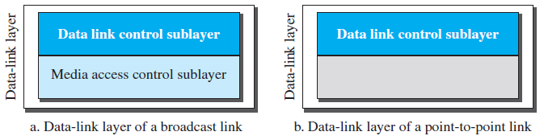
Media Access Control (MAC)
Media Access Control – responsible for resolving access to the shared link

Slide 4
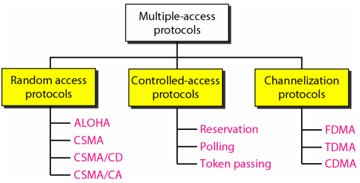
Multiple Access Protocols

Slide 5
Random Access Protocols

Slide 6
Random Access
Aka contention methods
No station is superior to another station and none is assigned the control over another
Each station that has data to send uses a procedure defined by the protocol to make a decision on whether or not to send
Decision depends on the state of the medium
No scheduled time for a station to transmit
No rules specify which station should send next

Slide 7
Random Access
If more than one station tries to send, there is an access conflict, called collision
  When can the station access the medium?
  What can the station do if the medium is busy?
  How can the station determine the success or failure of the transmission?
  What can the station do if there is an access conflict?

Slide 8
ALOHA
Earliest random access method
Developed at the University of Hawaii, 1970's
Designed for radio LAN
Medium (wireless) is shared between stations, collisions may happen

Slide 9
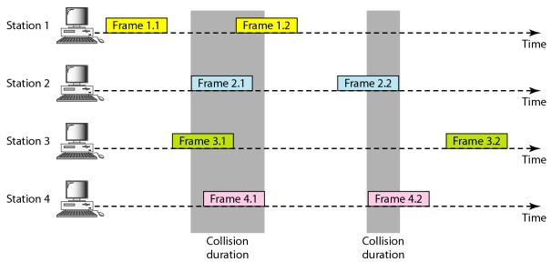
Pure ALOHA
Send whenever there is a frame to send

Slide 10
Pure ALOHA
Relies on ACKs
When the time-out period passes, each stations waits a random amount of time before re-sending its frame, back-off time, T_{B}
After a maximum number of re-transmission attempts K_{max}, a station must give up and try later
Binary exponential back-off: multiplier R in the range 0 to 2^{k}-1 is randomly chosen and multiplied by propagation time, T_{p} , to get T_{B}

Slide 11
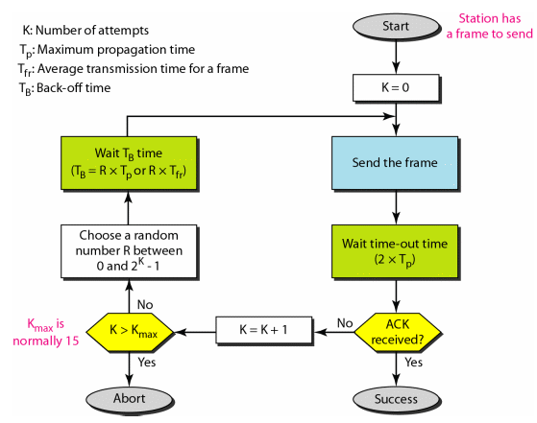
Pure ALOHA

Slide 12
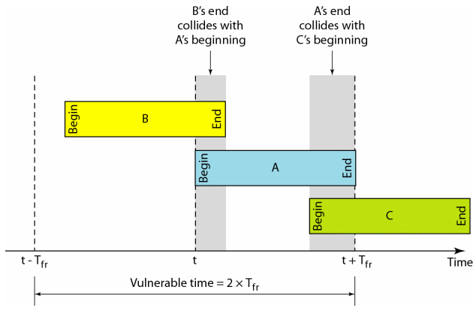
Pure ALOHA
Vulnerable time – time that a possibility of a collision might occur; 2 x T_{fr}

Slide 13
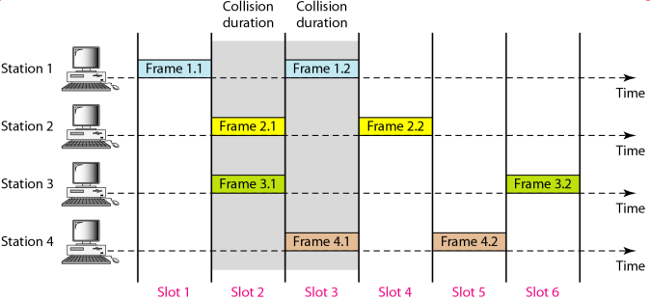
Slotted ALOHA
Improves the efficiency of Pure ALOHA
Divide the time into slots of T_{fr} and force the station to send only at the beginning of the time slot
Vulnerable time is T_{fr}

Slide 14
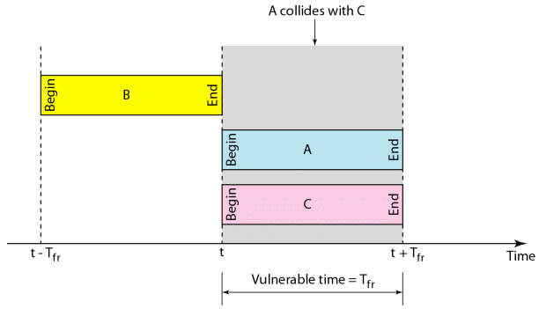
Slotted ALOHA

Slide 15
Carrier Sense Multiple Access (CSMA)
The chance of collision can be reduced if a station senses the medium before trying to use it
Each station first listens to the medium (check the state of the medium) before sending
“sense before transmit”, “listen before talk”
Can reduce possibility of collision but cannot eliminate it; because of propagation delay

Slide 16
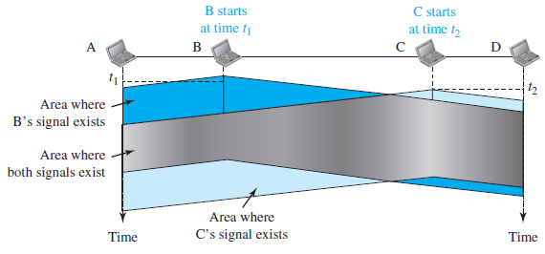
CSMA
Space/Time Collision

Slide 17
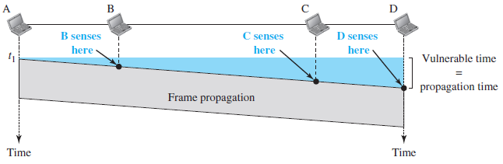
CSMA
Vulnerable time is the propagation time T_{p}

Slide 18
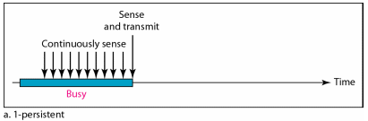
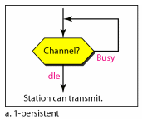
CSMA: 1-persistent
Station wishing to transmit listens to the medium
If medium is idle, transmit immediately
If medium is busy, continuously listen until medium becomes idle then transmit immediately

Slide 19
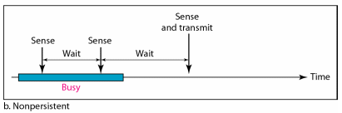
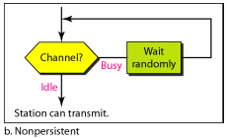
CSMA: Non-persistent
Station wishing to transmit listens to the medium
  If medium is idle, transmit
  If medium busy, wait a random amount of time and repeat

Slide 20
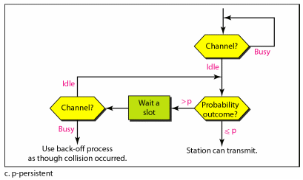
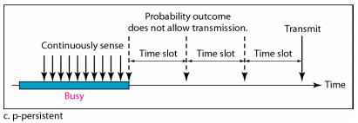
CSMA: P-persistent
Time is divided to slots where each slot typically equals maximum propagation delay
Station wishing to transmit listens to the medium
  If medium is idle
    transmit with probability (p), OR
    wait one slot with probability (1 – p), then repeat
  If medium busy, continuously listen until idle and repeat

Slide 21
CSMA/CD
Carrier Sense Multiple Access with Collision Detection
A station monitors the medium after it sends a frame if the transmission was successful
Widely used for bus topology LANs (IEEE 802.3 Ethernet)
Minimum Frame Size: T_{fr} = 2 x T_{p}
Before sending the last bit of the frame, sending station must detect a collision

Slide 22
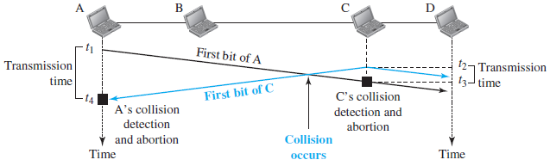
CSMA/CD
Collision of the first bits

Slide 23
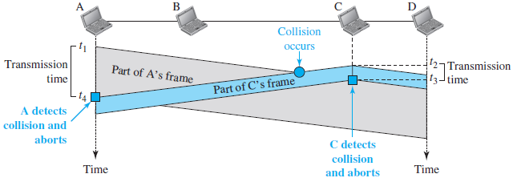
CSMA/CD
Collision and abortion

Slide 24
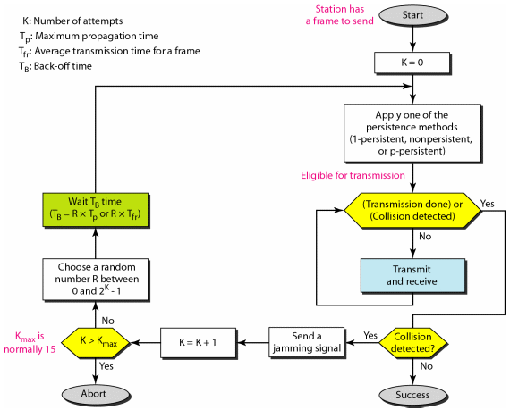
CSMA/CD

Slide 25
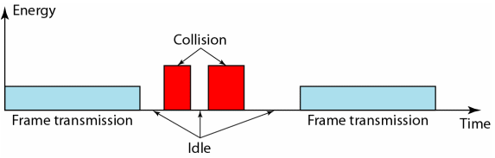
CSMA/CD
Energy level of the channel: zero (idle), normal (successful), abnormal (collision)

Slide 26
CSMA/CA
Carrier Sense Multiple Access with Collision Avoidance
A station needs to be able to receive while transmitting to detect collision
No collision: station receives it own signal
Collision: station receives it own signal and the signal transmitted by a second station
In wireless, collisions must be avoided because it is difficult to detect
Strategies: Interframe space, contention window, ACKs

Slide 27
CSMA/CA
Interframe Space (IFS)
  Defer transmission even if channel is idle
  Can be used to define the priority of a station
Contention Window
  An amount of time divided into slots
  Station must sense the channel after each time slot
  Does not restart the process if channel is busy
Acknowledgments
  guarantees receipt of frame

Slide 28
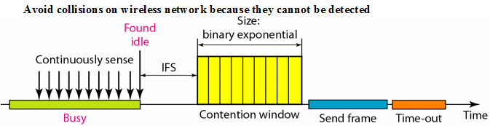
CSMA/CA
Timing

Slide 29
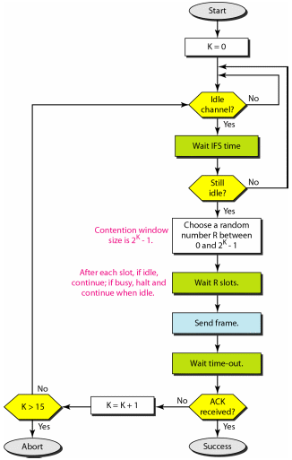
CSMA/CA

Slide 30
Controlled Access Protocols

Slide 31
Controlled Access
Stations consult one another to find which station has the right to send
A station cannot send unless it has been authorized by other stations
Methods: Reservation, Polling, Token Passing

Slide 32
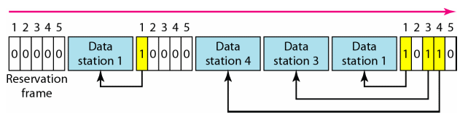
Reservation
Station must make a reservation before sending data
Time is divided into intervals, at each interval, a reservation frame precedes the data frame
N stations, N minislots in the reservation frame
Station that have made reservations can send data frames after reservation frame

Slide 33
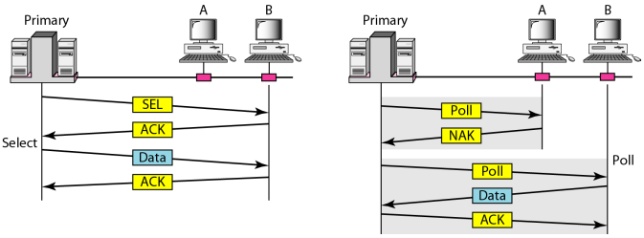
Polling
Designated primary and secondary stations
Data exchanges must be made through the primary device even when destination is a secondary
Primary station controls the link
Select
Poll

Slide 34
Polling
Select
  Used whenever primary has something to send
  Must check if the receiver is ready receive
  A SEL frame is send first, and station waits for ACK
Poll
  Used by primary to solicit transmissions from secondary devices
  Must poll all stations

Slide 35
Token Passing
Stations in a network is organized in a logical ring
For each station, there is a predecessor and a successor
Current station has access to channel, right to access has been passed from predecessor, will be passed to the successor
A special frame, token frame, circulates around the ring
Token frame gives right access to a station

Slide 36
Token Passing
Token Management
  Stations must be limited in the time they can have possession of the token
  Token must be monitored to ensure it has not been lost or destroyed
  Assign priorities to stations
  Low-priority stations must release the token to high priority stations

Slide 37
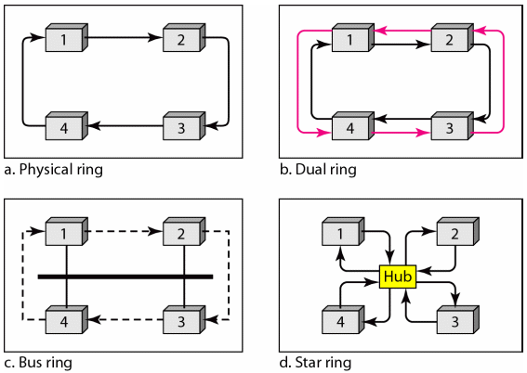
Token Passing

Slide 38
Channelization Protocols

Slide 39
Channelization
Multiple-access method in which available bandwidth of a link is shared in time, frequency, or code between different stations
Protocols: FDMA, TDMA, CDMA

Slide 40
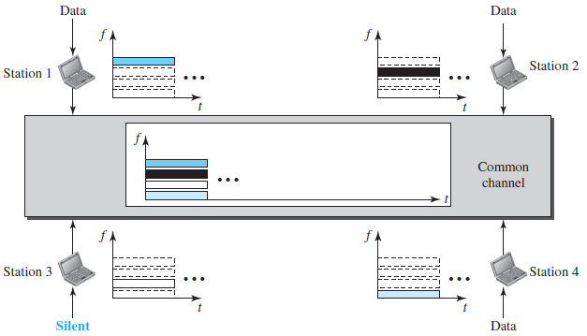
FDMA
Frequency-Division Multiple Access
Available bandwidth is divided into bands separated by guard bands

Slide 41
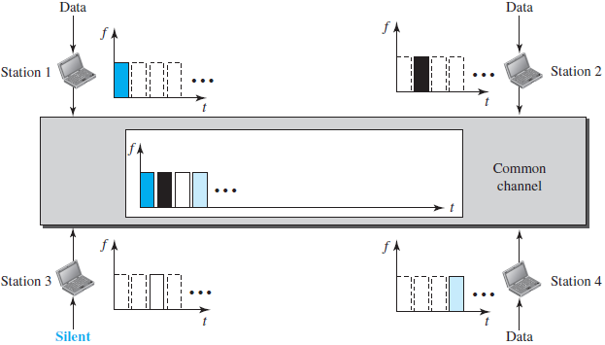
TDMA
Time-Division Multiple Access
Share the bandwidth of the channel in time
Sync problem present

Slide 42
CDMA
Code-Division Multiple Access
One channel carries all transmissions simultaneously
Communication with different codes
The stations receivers use these codes to recover the data for the desired station
It differs from FDMA in that only one channel occupies the entire bandwidth; it differs from TDMA in that all stations can send data simultaneously
Based on coding theory, each station is assigned a code, which is a sequence of numbers called chips

Slide 43
CDMA
Assume we have four stations 1,2,3,4
Data from station 1 are d₁, from station 2 are d₂, etc
Code assigned to station 1 is c₁, to the second is c₂
Assume the code has the ff. properties
  If we multiply each code by another we get 0
  If we multiply each code by itself we get 4 (number of stations)

Slide 44
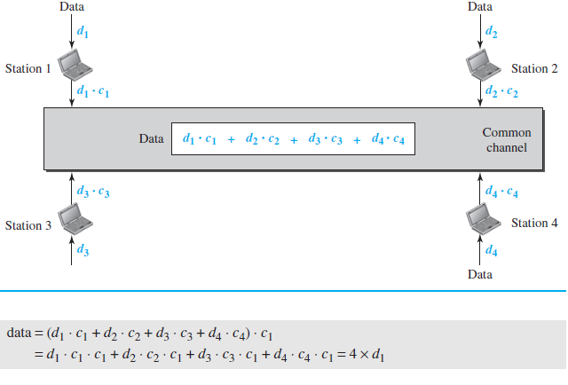
CDMA

Slide 45
References
Forouzan, B.A. 2013. Data Communications and Networking, 5th Ed. McGraw-Hill, New York.

